Slide 1
Hebron High School Dual Credit Parent Orientation
Notes:
Justin

Slide 2
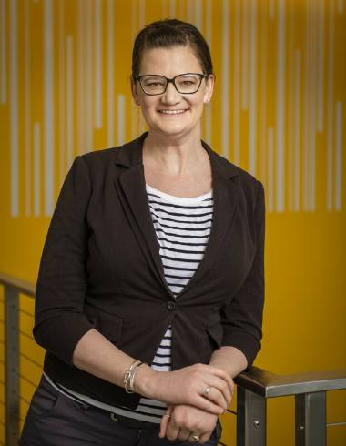
HELLO! I’m…
Dr. Jessica Ann Robinson, your College and Career Counselor for HHS
What do I do?
Coordinate dual credit program with HHS counseling team
One-on-one college and career planning visits
Classroom presentations
Major and career exploration
Scholarship assistance
College application essay writing
Notes:
Jessica

Slide 3
Students and Parents:
I would LOVE to meet with you!
Notes:
Jessica

Slide 4
Role Clarification: Dr. Robinson versus HHS Counseling Team
Dr. Robinson’s Role
HHS Counselors’ Roles
Works for Collin Community College
Focuses on Dual Credit and College and Career Planning
Does not work for LISD
Suggestions for Dual Credit versus Advanced Academics classes
Support and insight into College and Career planning process
Work for Lewisville Independent School District
Focuses on high school graduation requirements and other high school requirements
Does not work for Collin College
Facilitates course schedule changes, credit recovery, etc.
Support and insight into college and career planning process
Notes:
Justin

Slide 5
Collin College
Helpful Contacts
Testing Center
TSI testing, scores, etc.
Frisco Campus
972.377.1522
Tech Support
972.377.1777
(Available 24x7)
Online learning support: https://www.collin.edu/academics/ecollin/gettingstartedonline.html
Bursar/Cashier’s Office
Payments, payment plans, refunds, etc.
Frisco Campus
972.377.1636
Notes:
Jessica

Slide 6
Talking Points Today
01 COLLEGIATE EXPECTATIONS
02 ACADEMIC RESPONSIBILITIES
03 ACADEMIC NEED TO KNOW
04 COVER Q&A SUBMISSIONS
05 REMINDERS
Expectations of a college student
Academic responsibilities for a college student
Academic “Need to Know” bullet points
Common Frequently Asked Questions (FAQs)
Last-minute take-aways
Notes:
Jessica

Slide 7
COLLEGIATE EXPECTATIONS
YEAR AT A GLANCE
Notes:
Justin

Slide 8
DID YOU KNOW?
THERE WILL BE MANY DUE DATES AHEAD
Did you know that Collin College and LISD have different calendars?
It is important to make sure you have both saved to your device each year. Utilize a planner!
Notes:
Justin

Slide 9
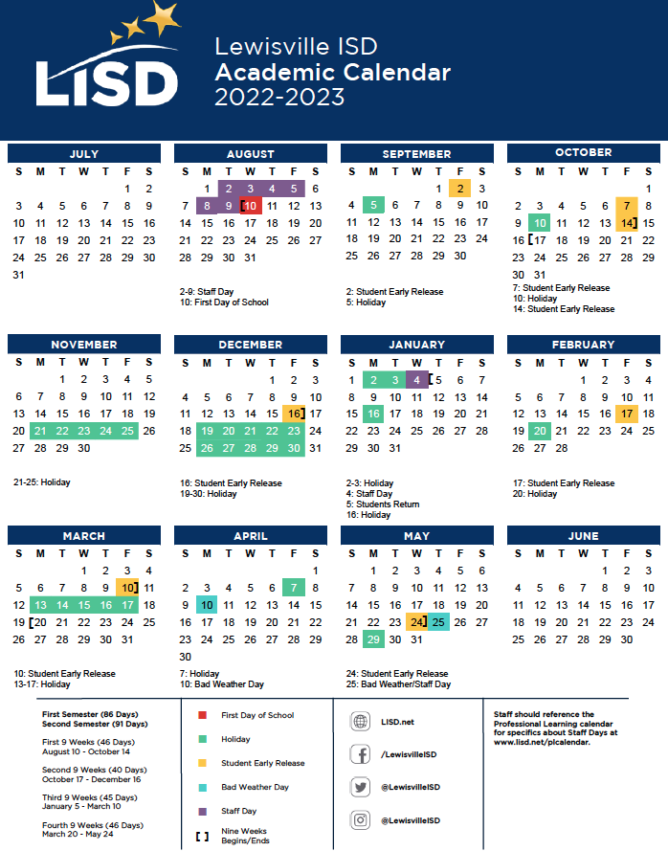
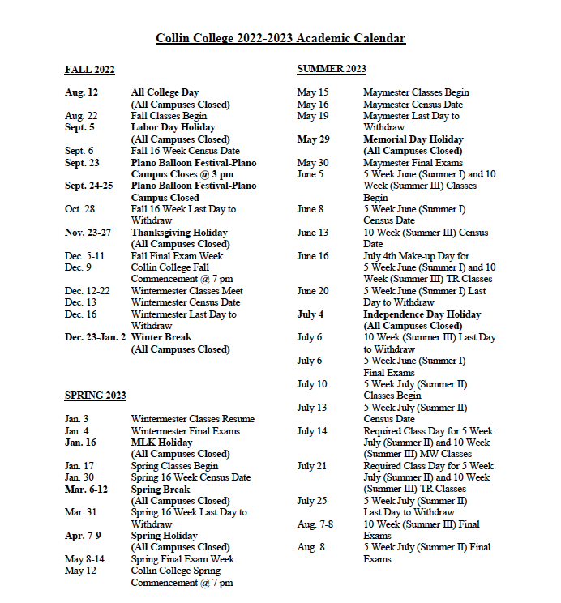
CALENDARS
Click calendar for link
Notes:
Justin

Slide 10
Important Dates
FALL 2022
SPRING 2023
First Day of School: August 10
First Day of Collin Classes: August 22
NorTex College Fair: September 12 (UNT Union 6:30-8:30pm)
FAFSA/TASFA Opens: October 1
LISD Closed: Monday October 10
October 25th: PSAT
October 27th: SAT School Day
Fall Withdrawal Deadline (Collin): October 28
Collin Thanksgiving break: November 23-25 (note: LISD gives the entire week)
Collin Final Exams: Week of December 4
HHS End of Semester 1: December 16
First Day of School: January 5
First Day of Collin Classes: January 17
Spring Withdrawal Deadline: March 31
Collin Final Exams: Week of May 8
Hebron End of Semester 2: May 24
Reminder: Please pay attention to
Important dates like:
Testing dates (AP, SAT, TSI, ACT)
College visits
Big, event-heavy weeks: Homecoming, Spring Fling, etc.

Slide 11
An hour of planning can save you hours of doing
― Irene M. Pepperberg
Notes:
Jessica

Slide 12
Friday’s (and/or Cancelled DC Course Periods)
Dual Credit classes will not meet on Friday’s. Students must treat their Friday schedule as if their dual credit class functioned, on Fridays, like an off period.
For example…
If students have DC 1st period, they are to report to 2nd period as usual.
If students have DC 4th period, then they must leave after their 3rd period class.
If students have a DC class 3rd period, but nothing 4th period (senior off) OR another DC class during 4th period, then they will need to leave the campus after their 2nd period.
If students have a DC class 3rd period as well as another Hebron class 4th period (or a program like sports, choir, theater, etc.), then they will need to go to their coach or to the library. Those who are responsible to go to the library have already been contacted.
Students are NOT to remain on campus during their dual credit period if the course is not in session. The only exception to this regards when students do not have transportation and ride the bus. In these situations, students will need to go to the library.
Notes:
Justin

Slide 13
Collin Tutors on Campus
All resources at Collin College are open to students!
Anthony Pearson Centers for Academic Excellence
Services Offered
The mission of the Anthony Peterson Center for Academic Assistance is to provide FREE and ONLINE
learning support to students and community members in a welcoming environment of integrity,
dignity, and creativity. By offering professional tutoring services and educational resources for
improving key skills related to various content areas, the center strives to empower learners to
become independent thinkers, poised for success in college and beyond.
Subject specific course tutoring
Math Lab
Writing Lab
Science Lab
Assistance with papers and projects
Test preparation
Interested?
Writing assistance: PRCWritingCenter@collin.edu
Math assistance: FriscoMathLab@collin.edu
Notes:
Jessica

Slide 14
Academic Responsibilities
Notes:
Jessica

Slide 15
Academic Standing: What does this mean?
In Dual Credit, students are starting their COLLEGE transcript
Good Standing: Indicates a student has earned a cumulative GPA of 2.0 or higher.
Academic Warning: This occurs immediately following the first semester a student’s cumulative GPA falls below a 2.0. No holds are placed on students account and they are still allowed to take up to 18 credit hours; however, students will meet with an advisor to discuss how to get their GPA back to Good Standing.
https://www.collin.edu/gettingstarted/financialaid/SAP.html
Notes:
Jessica

Slide 16
Academic Standing Continued…
Academic Probation: This occurs immediately following Academic Warning if a student does not raise their GPA back to a 2.0. A hold is placed on the student’s account and they are limited to 13 credit hours max. Students who make Academic Progress, will remain on Academic Probation until their GPA reaches a 2.0 and they are back in Good Standing.
Academic Suspension and removal from Dual Credit: This occurs when students on Academic Probation do not maintain Academic Progress. Students on Academic Suspension are required to sit out for one semester and a hold is placed on their account.
https://www.collin.edu/gettingstarted/financialaid/SAP.html
Notes:
Jessica

Slide 17
Transcripts/Grades
Hebron High School course grades will automatically be added to students LISD transcripts after each nine weeks.
Dual Credit course grades are added manually to students LISD transcripts after each semester (January for Fall, May for Spring, August for Summer if taking a summer class(es). Students will receive a letter grade on Collin Transcripts and a numerical grade on LISD Transcripts.
Notes:
Justin

Slide 18
Transcripts/Grades
Students are always encouraged to double check the accuracy of their dual credit grades on LISD transcripts after manual entry.
Skyward > Student Access > Portfolio > 2023 Transcript
Notes:
Justin

Slide 19
GPA/Rank
LEVEL 0 | LEVEL 1 | LEVEL 2 | LEVEL 3
1.0 Multiplier | 1.1 Multiplier | 1.15 Multiplier | 1.2 Multiplier
Courses with modified content as decided by a student’s ARD Committee, credit recovery courses completed on campus, Night School, Summer School for credit recovery, accelerated courses at LLC | On-level general education courses (English 1, Geometry, Biology, etc.) | Honors courses (Honors English II, Honors Algebra 2, Honors Chem ,etc.) | Dual credit courses, AP courses, Academic Decathlon
Notes:
Justin

Slide 20
GPA/Rank
https://www.lisd.net/gpa
Many factors play a role in determining a student’s class rank/GPA. It is important to understand how this is calculated per LISD.
https://www.collin.edu/gettingstarted/advising/courses_grades.html
Notes:
Justin

Slide 21
Textbooks
Policy moving forward:
Students will need to purchase their books every semester from Collin College’s bookstore.
Suggestion: Take a family trip to a Collin bookstore, pick up your books, and get your SWAG.
Important Note: You are a Collin College student, so please make sure you purchase your textbooks as a part of the experience. This is the student’s responsibility.
Notes:
Jessica

Slide 22
Academic
Need to Know
Notes:
Jessica

Slide 23
Academic Need to Know: FERPA
Collin College Grades
Collin College FERPA Laws
Parents are not able to view student dual credit grades in their own account as is done with Skyward.
Parents may access student grades through their student’s account
Hebron High School Counselors can access a student’s dual credit grade at anytime by contacting professors through “legitimate educational interest” as defined in the LISD Handbook
As you may know, college students have a right to confidentiality and privacy. Professors, Collin Counselors, and other Collin College staff cannot provide parents with details about holds or grades, among other information.
Students that would like to grant access to their protected information may do so within their Cougar Web. From the “Home” tab, find “Student Quick Links”, and click on: “Review/Update FERPA Authorizations.”
Notes:
Jessica

Slide 24
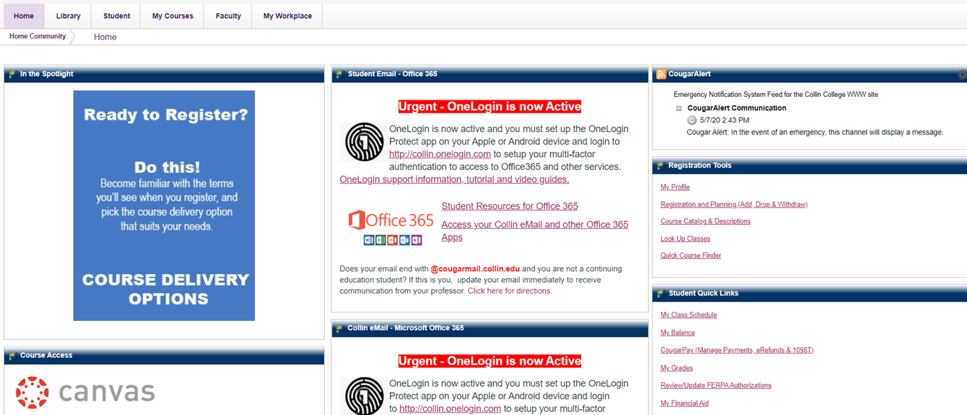
FERPA: The Form
Notes:
Jessica

Slide 25

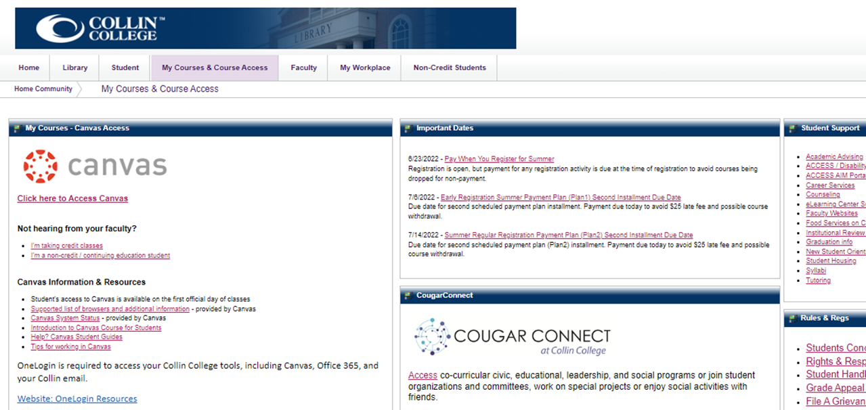
Canvas Courses
Check daily!
Collin updates each semester, the day students begin class.
Once inside Canvas, you can use the side navigation panel to find your class(es)
From the “My Courses” tab,
click on Access Canvas
Notes:
Jessica

Slide 26
Emails/Communication
Students need to check BOTH their LISD email AND Collin College email accounts regularly! Important updates and messages from professors, teachers and counselors are sent regularly via email. Connect your email accounts to your phone, iPad or other device so that you don’t miss important communications!
PARENTS: Please ensure your contact #s and email are correct in Skyward
Notes:
Justin

Slide 27
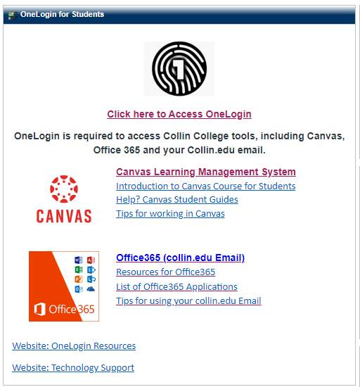
SETTING UP YOUR EMAIL
Collin College has transitioned to a more secure login system using Microsoft Office.
You will need to download the OneLogin app to your phone.
Make sure you can log into your Collin email BEFORE the first day of class.
This information can be found on the “Home” tab of your CougarWeb. We recommend the Outlook app for quick access to your emails.
Notes:
Jessica

Slide 28
ACT and SAT Test Dates and Study Resources
Khan Academy
Union Test Prep
ACT Test Prep
PSAT: Tuesday, October 25th (ALL 10th and registered 11th)
SAT: Thursday, October 27th (Seniors ONLY)
Notes:
Justin

Slide 29
Texas Common Core Numbering System
The Texas Common Course Numbering System (TCCNS) is a voluntary, co-operative effort among 134 Texas community colleges and universities to facilitate transfer of freshman and sophomore level general academic coursework. TCCNS provides a shared, uniform set of course designations for students and their advisors to use in determining both course equivalency and degree applicability of transfer credit on a statewide basis. When students transfer between two participating TCCNS institutions, a course taken at the sending institution transfers as the course carrying the same TCCNS designation at the receiving institution.
Notes:
Jessica

Slide 30
Q&A
Submissions
Notes:
The team—where we will answer any other questions that our parents may have

Slide 31
Are students required to go to Collin College for anything?
No HOWEVER students can always TSI test there if needed at the Testing Center. We do encourage students to take advantage of opportunities at the Collin College campuses - they/you are paying for them! Examples include the writing lab and math lab with tutors to assist, library, makerspace with access to 3D printers, etc. 9th Grade students will tour the Frisco Campus this fall.
Notes:
Jessica

Slide 32
If a student retakes a class does the new grade replace the old?
FOR LISD - Both grades will stay on the LISD transcript and BOTH are calculated into weighted GPA that determines class rank
FOR COLLIN COLLEGE - Both grades are viewable in academic history but only the new grade is factored into GPA
Notes:
Jessica (Collin’s side) and Justin (Hebron’s side)

Slide 33
Can my student drop if they aren’t doing well?
Please meet with your Hebron counselor BEFORE making this decision to make sure your Hebron schedule can accommodate the change.
Please be aware of the last day to drop each semester at COLLIN, as well.
Fall 2022: October 28th, 2022
Spring 2023: March 31st, 2023
Notes:
Jessica

Slide 34
How can a student see their Collin College course history?
Cougar Compass Degree Audit
Notes:
Jessica

Slide 35
Final “Take Aways” for Dual Credit Parents
When in doubt, have your student check COLLIN’s canvas, and check COLLIN email
The student is the main person who needs to contact the professor
If you have questions about your child’s grade, please ask them to pull up their Collin canvas account.
Your student is a college student, and please make sure to fully enjoy this experience—it’s a super neat opportunity for them to develop:
  Personally
  Professionally
  Academically
  Emotionally
  Socially
Notes:
Justin (Hebron take-aways)
Jessica (Collin take-aways)

Slide 36
Additional Resources
Collin College FAQ: https://www.collin.edu/campuslife/studentlife/faqs.html
Collin College Tutoring Services: https://www.collin.edu/studentresources/tutoring/
Collin College Disability Services: https://www.collin.edu/studentresources/disabilityservices/index.html
Notes:
Jessica

Slide 37
THANK YOU!
DO YOU HAVE ANY QUESTIONS?
Dual Credit Programming Team:
Dr. Justin Fields: FieldsJR@lisd.net
Mrs. Latasha Rayford: RayfordLM@lisd.net
Mrs. Janel Renee: ReneeJ@lisd.net
Dr. Jessica Robinson: JARobinson@Collin.edu
Notes:
Justin and Jessica

